Slide 1

© 2007 Prentice Hall, Inc. All rights reserved.
11–<number>

Slide 2

  The transfer and understanding of meaning.
  Interpersonal Communication
    Communication between two or more people
  Organizational Communication
    All the patterns, network, and systems of communications within an organization
© 2007 Prentice Hall, Inc. All rights reserved.
11–<number>

Slide 3

Message
  Source: sender’s intended meaning
Encoding
  The message converted to symbolic form
Channel
  The medium through which the message travels
Decoding
  The receiver’s retranslation of the message
Noise
  Disturbances that interfere with communications
© 2007 Prentice Hall, Inc. All rights reserved.
11–<number>

Slide 4
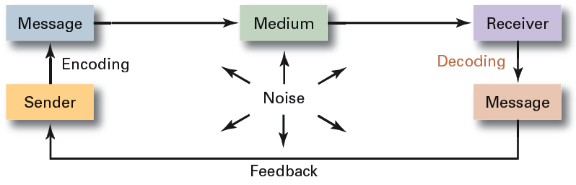
Exhibit 11–1 The Interpersonal Communication Process
© 2007 Prentice Hall, Inc. All rights reserved.
11–<number>

Slide 5

© 2007 Prentice Hall, Inc. All rights reserved.
11–<number>

Slide 6
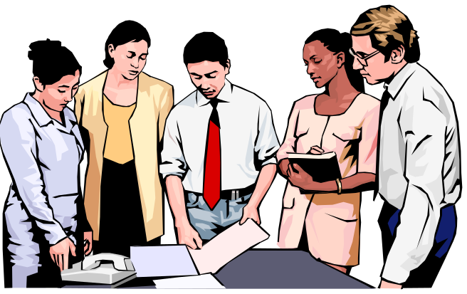
Face-to-face
Telephone
Group meetings
Formal presentations
Memos
Traditional Mail
Fax machines
Employee publications
Bulletin boards
Audio- and videotapes
Hotlines
E-mail
Computer conferencing
Voice mail
Teleconferences
Videoconferences
© 2007 Prentice Hall, Inc. All rights reserved.
11–<number>

Slide 7
Feedback
Confidentiality
Time-space constraint
Cost
Formality
Time consumption
© 2007 Prentice Hall, Inc. All rights reserved.
11–<number>

Slide 8
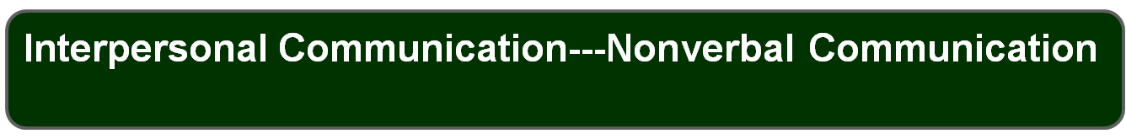
  without words.
    Sounds with specific meanings or warnings
    Images that control or encourage behaviors
    Situational behaviors that convey meanings
    Clothing and physical surroundings that imply status
  Body language: gestures, facial expressions, and other body movements that convey meaning.
  Verbal intonation: emphasis that a speaker gives to certain words or phrases that conveys meaning.
© 2007 Prentice Hall, Inc. All rights reserved.
11–<number>

Slide 9

Filtering
National
Culture
Emotions
Language
Interpersonal Communication
Information
Overload
Defensiveness
© 2007 Prentice Hall, Inc. All rights reserved.
11–<number>

Slide 10
Barriers to Effective Interpersonal Communication
Filtering
  The deliberate manipulation of information to make it appear more favorable to the receiver.
Emotions
  Disregarding rational and objective thinking processes and substituting emotional judgments when interpreting messages.
Information Overload
  Being confronted with a quantity of information that exceeds an individual’s capacity to process it.
© 2007 Prentice Hall, Inc. All rights reserved.
11–<number>

Slide 11
Barriers to Effective Interpersonal Communication (cont’d)
Defensiveness
  When threatened, reacting in a way that reduces the ability to achieve mutual understanding.
Language
  The different meanings of and specialized ways (jargon) in which senders use words can cause receivers to misinterpret their messages.
National Culture
  Culture influences the form, formality, openness, patterns and use of information in communications.
© 2007 Prentice Hall, Inc. All rights reserved.
11–<number>

Slide 12
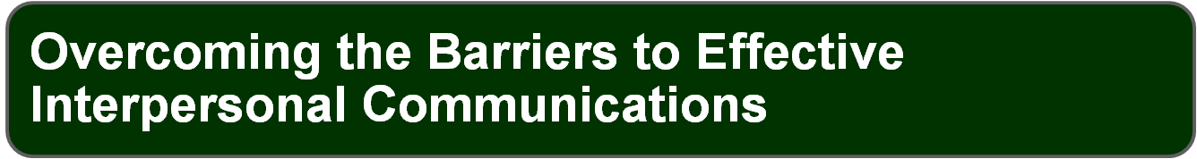

Use Feedback
Simplify Language
Listen Actively
Constrain Emotions
Watch Nonverbal Cues
© 2007 Prentice Hall, Inc. All rights reserved.
11–<number>

Slide 13
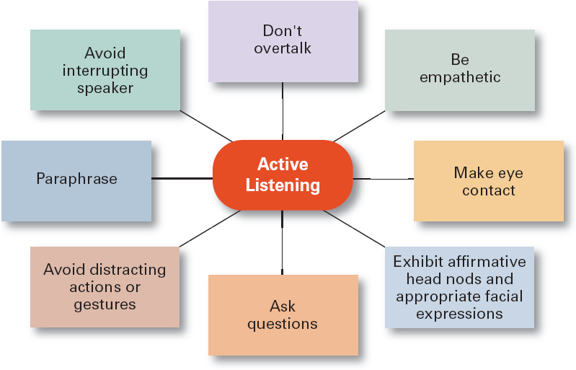
Exhibit 11–3 Active Listening Behaviors
Source: Based on P.L. Hunsaker, Training in Management Skills (Upper Saddle River, NJ: Prentice Hall, 2001).
© 2007 Prentice Hall, Inc. All rights reserved.
11–<number>

Slide 14


Diagonal
Upwa
r
d
Downwa
r
d
Lateral
© 2007 Prentice Hall, Inc. All rights reserved.
11–<number>

Slide 15
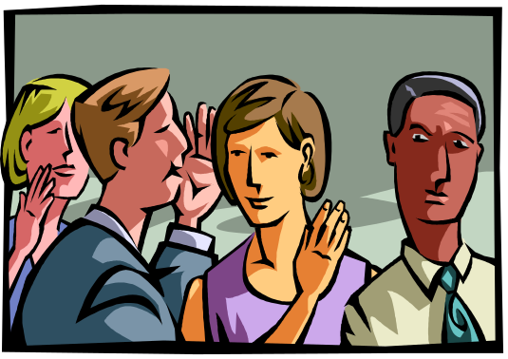
An informal organizational communication network that is active in almost every organization.
© 2007 Prentice Hall, Inc. All rights reserved.
11–<number>

Slide 16

Managing Communication in an Internet World
  Legal and security issues
  Lack of personal interaction
  Communicating Effectively with Customers
© 2007 Prentice Hall, Inc. All rights reserved.
11–<number>

Slide 17

“Politically Correct” Communication
Do not use words or phrases that stereotype, intimidate, or offend individuals based on their differences.
However, choose words carefully to maintain as much clarity as possible in communications.
© 2007 Prentice Hall, Inc. All rights reserved.
11–<number>

